Slide 1
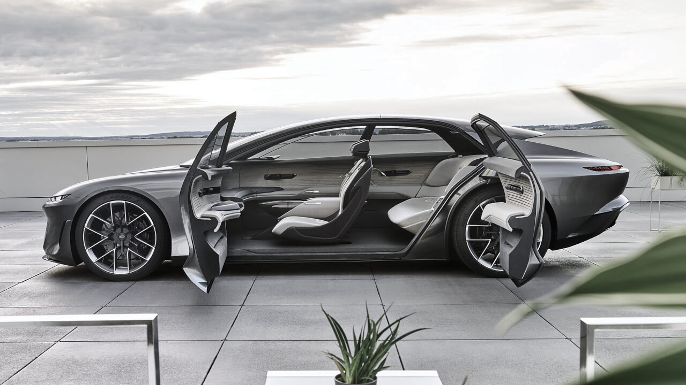
Used Car Price Prediction Project Presentation
Submitted by G. Premsagar

Slide 2
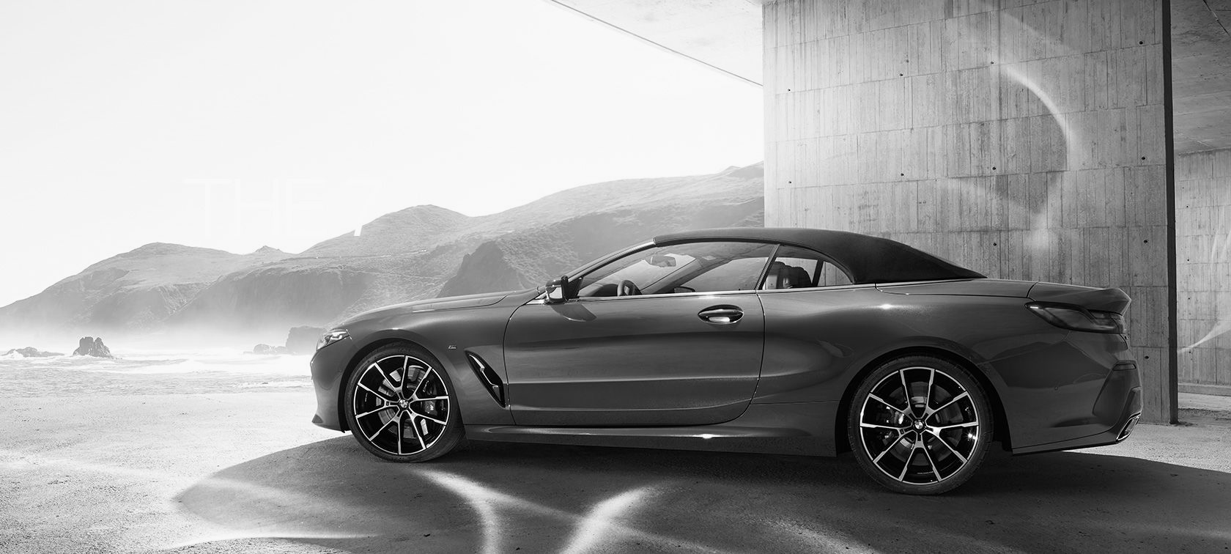
ACKNOWLEDGMENT
I'd like to express my heartfelt gratitude to my SME (Subject Matter Expert) Khushboo Garg, as well as Flip Robo Technologies, for allowing me to work on this project on Used Car Price Prediction and for assisting me in conducting extensive research, which allowed me to learn a lot of new things, particularly in terms of data collection.
In addition, I used a few outside resources to help me finish the project. I made sure to learn from the samples and adjust things to fit my project's needs.

Slide 3
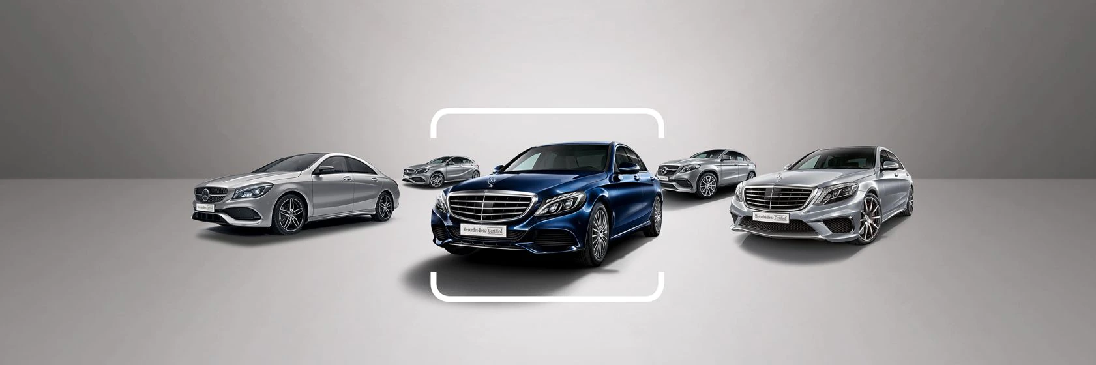
ACKNOWLEDGMENT
All the external resources that were used in creating this project are listed below:
1) https://www.youtube.com/
2) https://www.google.com/
3) https://github.com/
4) https://scikit-learn.org/stable/user_guide.html
5) https://www.kaggle.com/
6) https://www.analyticsvidhya.com/
7) https://medium.com/
8) https://towardsdatascience.com/

Slide 4
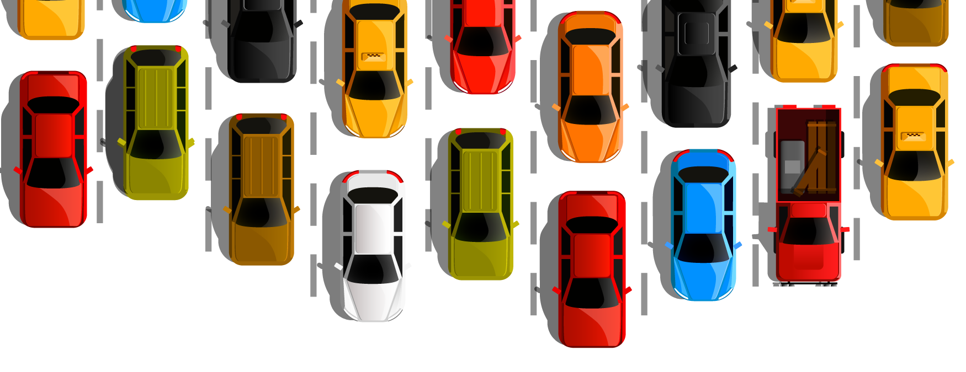
PROBLEM STATEMENT
With the covid 19 impact in the market, we have seen lot of changes in the car market. Now some cars are in demand hence making them costly and some are not in demand hence cheaper. One of our clients works with small traders, who sell used cars. With the change in market due to covid 19 impact, our client is facing problems with their previous car price valuation machine learning models. So, they are looking for new machine learning models from new data. We have to make car price valuation model.

Slide 5

DATA COLLECTION PHASE
You have to scrape at least 5000 used cars data. You can scrape more data as well, it’s up to you. more the data better the model
In this section You need to scrape the data of used cars from websites (OLX, Car Dekho, Cars 24 etc.) You need web scraping for this. You have to fetch data for different locations. The number of
columns for data doesn’t have limit, it’s up to you and your creativity. Generally, these columns are Brand, model, variant, manufacturing year, driven kilometers, fuel, number of owners, location and at last target variable Price of the car. This data is to give you a hint about important variables in used car model. You can make changes to it, you can add or you can remove some columns, it completely depends on the website from which you are fetching the data.
Try to include all types of cars in your data for example- SUV, Sedans, Coupe, minivan, Hatchback.

Slide 6

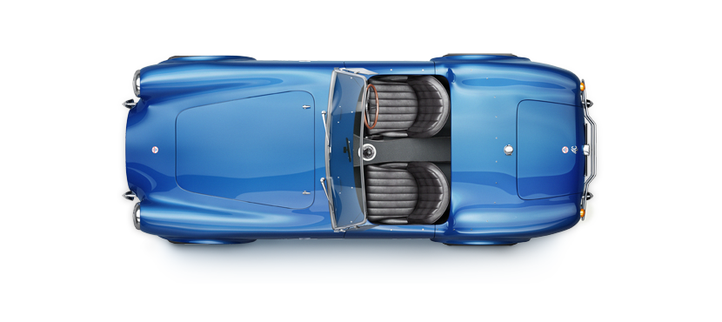
MODEL BUILDING PHASE
After collecting the data, you need to build a machine learning model. Before model building do all data pre-processing steps. Try different models with different hyper parameters and select the best model. Follow the complete life cycle of data science. Include all the steps below.
1. Data Cleaning
2. Exploratory Data Analysis
3. Data Pre-processing
4. Model Building
5. Model Evaluation
6. Selecting the best model

Slide 7
DATA SCIENCE LIFE CYCLE
Data Cleaning
Import the collected data from web scraping
Exploratory Data Analysis
Check through all the dataset information like datatype, missing value, duplicate value etc.
Visualization and Data Preprocessing
Use various visualization methods to check the data distribution identify presence of outliers and skewness.
Clean and format the records as per usage by using various imputation techniques.
Analyze each and every data record to ensure we have usable information.
Perform encoding and scaling methods.

Slide 8
DATA SCIENCE LIFE CYCLE
Model Building
Create appropriate Regression Machine Learning model function
Model Evaluation
Usage of evaluation metrics to check the accuracy of the models over trained and test data inputs
Hyperparameter Tuning Best Model
Choosing the appropriate Regression Machine Learning model to check various parameter permutation and combinations
Need to ensure that whenever the regression function is called it is able to process all the necessary parameters
Ensure the cross validation techniques helps in reducing over fitting and under fitting data
Using Grid Search CV to obtain the best parameters that can be plugged into the selected model

Slide 9
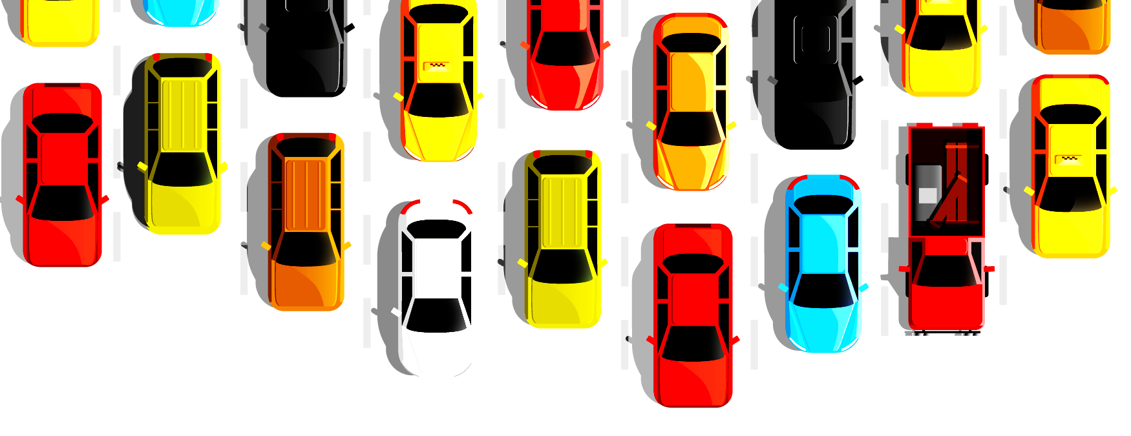
WEB SCRAPING FOR USED CAR DETAILS
olx
cardekho
cars24
ola

Slide 10
DATA PREPROCESSING
Importing the necessary dependencies and libraries.
Reading the CSV file and converted into data frame.
Checking the data dimensions for the original dataset.
Looking for null values and accordingly fill the missing data.
Checking the summary of the dataset.
Checking unique values.
Checking all the categorical columns in the dataset.

Slide 11
DATA PREPROCESSING
Visualizing each features using matplotlib and seaborn.
Performing encoding using the ordinal encoder on categorical features.
Checking for co-relation/multi-collinearity in a heatmap.
Checking for Outliers/Skewness using boxen plot and distribution plot.
Perform Scaling using Standard Scaler method.
Checking for the final dimension of dataset to confirm the input details.
Creating train test split and the best random state found in the range 1-1000.

Slide 12
TECHNOLOGY USED
Hardware technology being used :-
CPU : MacBook Pro
Chip : Apple M1 - 8 (4 performance and 4 efficiency)
RAM : 8 GB
GPU : 8 GB
Software technology being used :-
Programming language : Python
Distribution : Anaconda Navigator
Browser based language shell : Jupyter Notebook
Libraries/Packages specifically being used :-
Pandas, NumPy, matplotlib, seaborn, scikit-learn, pandas-profiling, missingno.

Slide 13
EXPLORATORY DATA ANALYSIS (EDA) AND VISUALIZATION
01. Univariate Analysis
Univariate analysis is the simplest form of analyzing data. “Uni” means “one”, so in other words your data has only one variable.
02. Multivariate Analysis
Multivariate analysis is a set of statistical techniques used for analysis of data that contain more than one variable.
03. Correlation of Dataset
04. Correlation with Target variable
05. Conclusion
Summary with the conclusion of all the analysis
Correlation with the target variable to know how the data is related.
Correlation is used to test relationships between quantitative variables or categorical variables.

Slide 14
EXPLORATORY DATA ANALYSIS (EDA)
Shape : 10,000 rows and 6 columns
No null values present
Few duplicate rows/records were found
Datatype of only object columns are in dataset
First, I loaded the complete dataset into our Jupyter Notebook after importing the appropriate libraries and renaming the project file from untitled.
Then I looked at the layout of our data and saw that we had 10,000 rows and six distinct columns.
We don't have any null or missing values in our web scraping dataset.
Although our dataset contains a few duplicate rows/records, I choose to keep them rather than delete them.
By looking at the data types, I discovered that our data collection included columns with just object datatypes, even if numeric data was there.

Slide 15
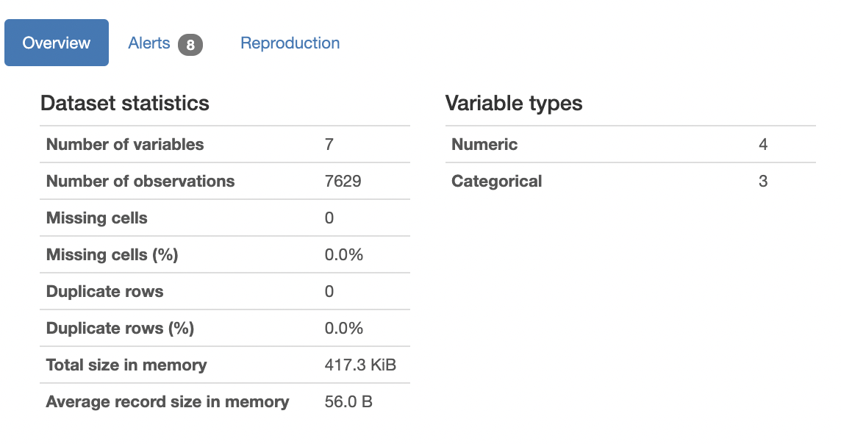
VISUALIZATION USING PANDAS PROFILING REPORT

Slide 16
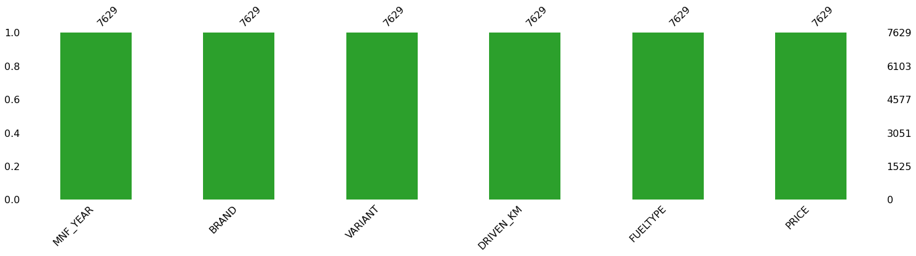
MISSING VALUES VISUAL USING MISSINGNO

Slide 17
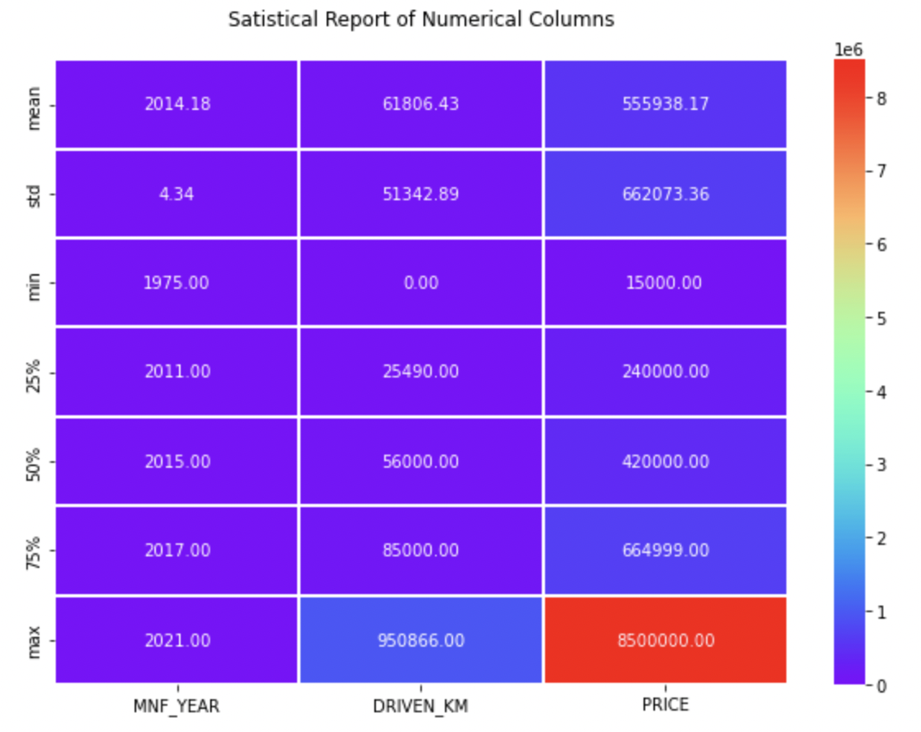
DESCRIBE DATASET VISUAL ON NUMERIC DATA

Slide 18
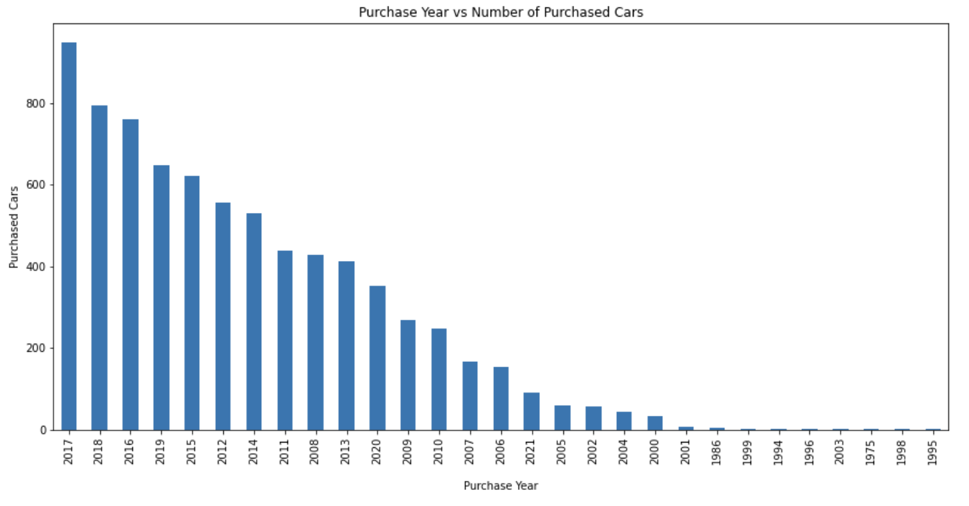
PURCHASE DETAILS OF USED CARS EACH YEAR

Slide 19
COUNT PLOTS

Slide 20
BAR PLOTS

Slide 21
PAIR PLOTS

Slide 22
OUTLIERS WITH BOXEN PLOTS

Slide 23
SKEWNESS WITH DISTRIBUTION PLOTS

Slide 24
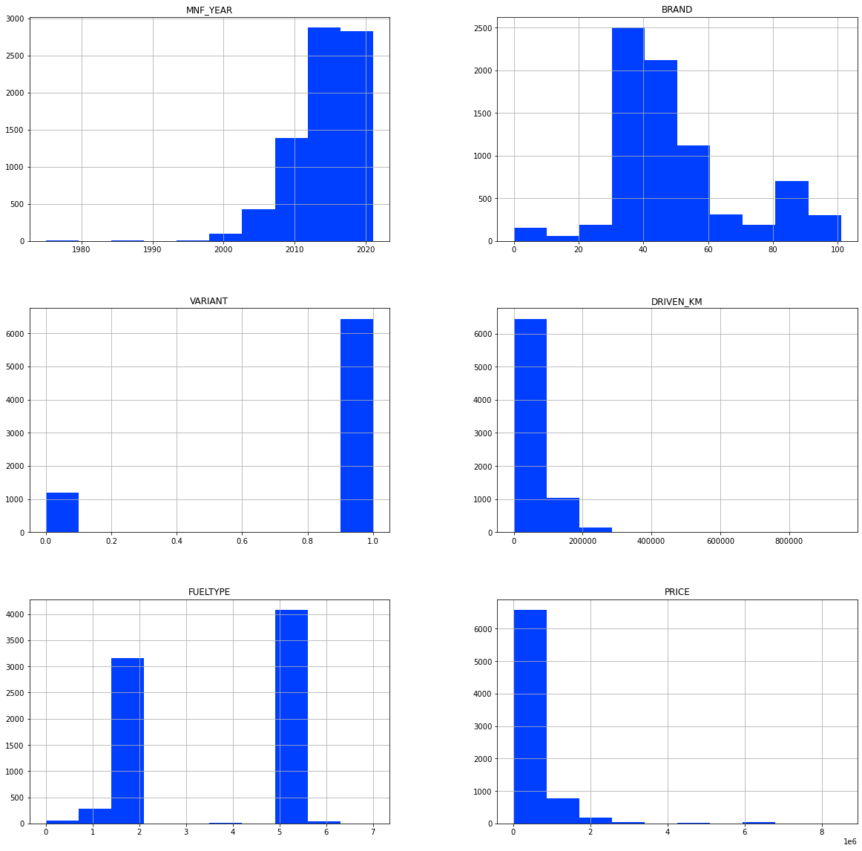
HISTOGRAM

Slide 25
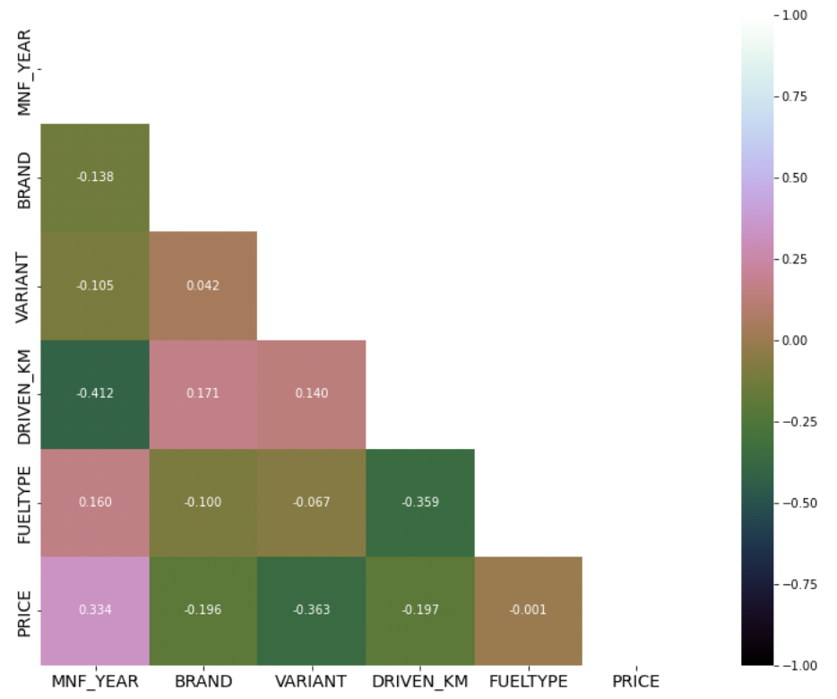
HEATMAP

Slide 26
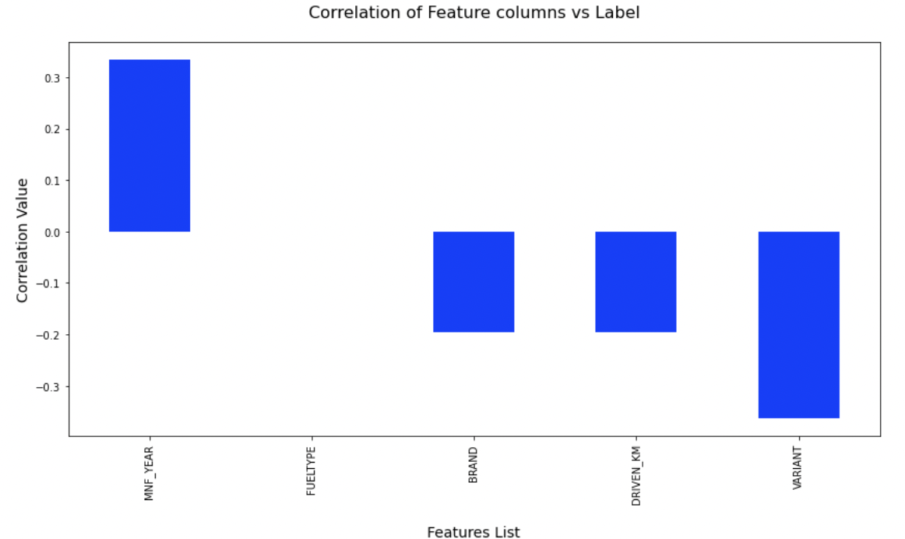
CORRELATIONS BAR GRAPH

Slide 27
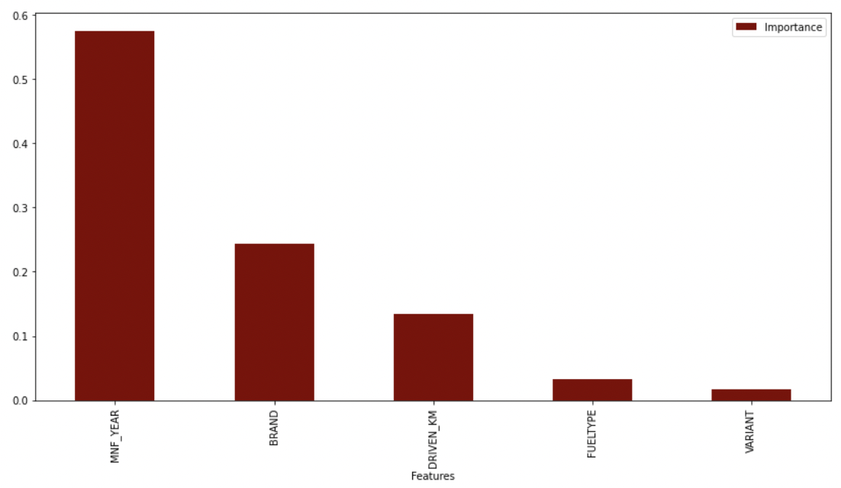
FEATURE IMPORTANCE BAR GRAPH

Slide 28
MODEL TRAINING PHASES
Get Data
Clean, Prepare & Manipulate Data
Train Model
Test Data
Improve

Slide 29
REGRESSION
MACHINE LEARNING MODELS / USED
Linear Regression Model
Ridge Regularization Model
Lasso Regularization Model
Support Vector Regression Model
Decision Tree Regression Model
Random Forest Regression Model
K Neighbours Regression Model
Gradient Boosting Regression Model
Ada Boost Regression Model
Extra Trees Regression Model

Slide 30
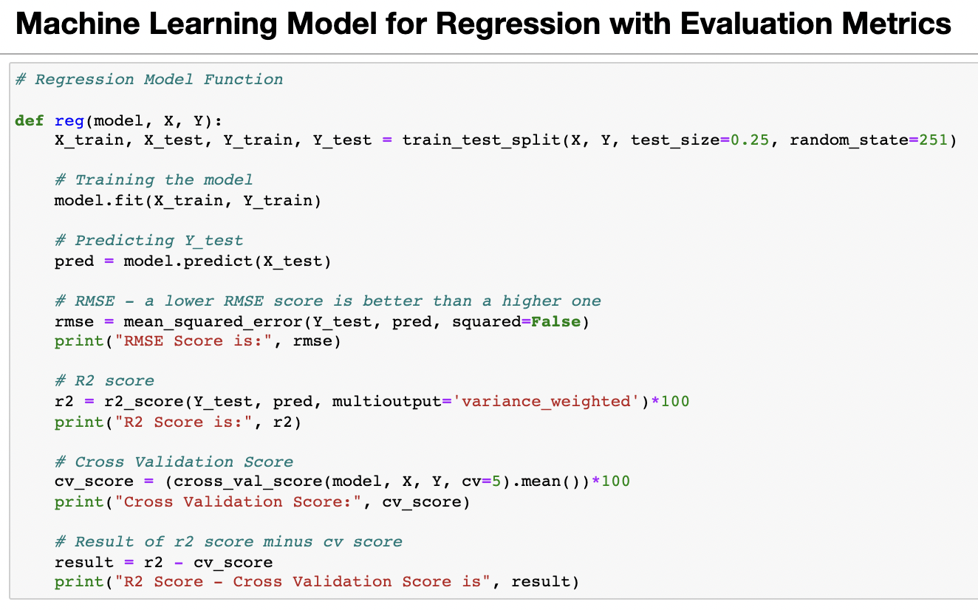
REGRESSION MODEL FUNCTION WITH EVALUATION METRICS

Slide 31
RESULT OF MULTIPLE REGRESSION MODELS

Slide 32
EVALUATION AND HYPER PARAMETER TUNING
The key metrics used here were:
R2 score
Cross Validation Score
MAE
MSE
RMSE
Using Hyperparameter Tuning, we sought to discover the optimal parameter list to improve our accuracy ratings. We utilized the Grid Search CV technique with 5 folds to attain a higher score.

Slide 33
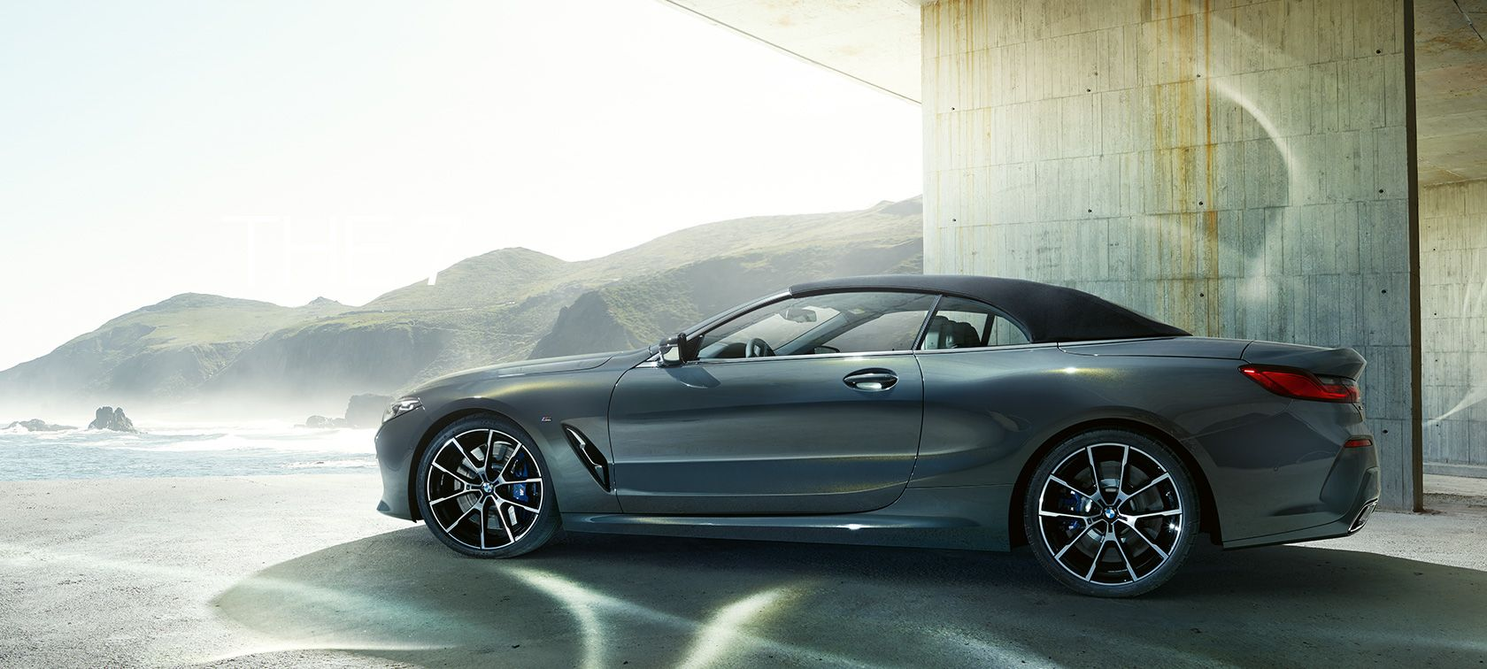
CONCLUSION
We gained knowledge into how to gather data, pre-process the data, analyses the data, and construct a model after completing this project. First, we utilized Web Scraping to acquire data on used automobiles from several websites such as OLX, Car Dekho, Cars 24, and OLA.
Beautiful Soup and Selenium were utilized for web scraping, which provides the advantage of automating our data collection process. We gathered about 10,000 pieces of information, including the selling price of used autos and other relevant details. The scraped data was then integrated into a single data frame and saved as a csv file, which we could then open and examine.

Slide 34
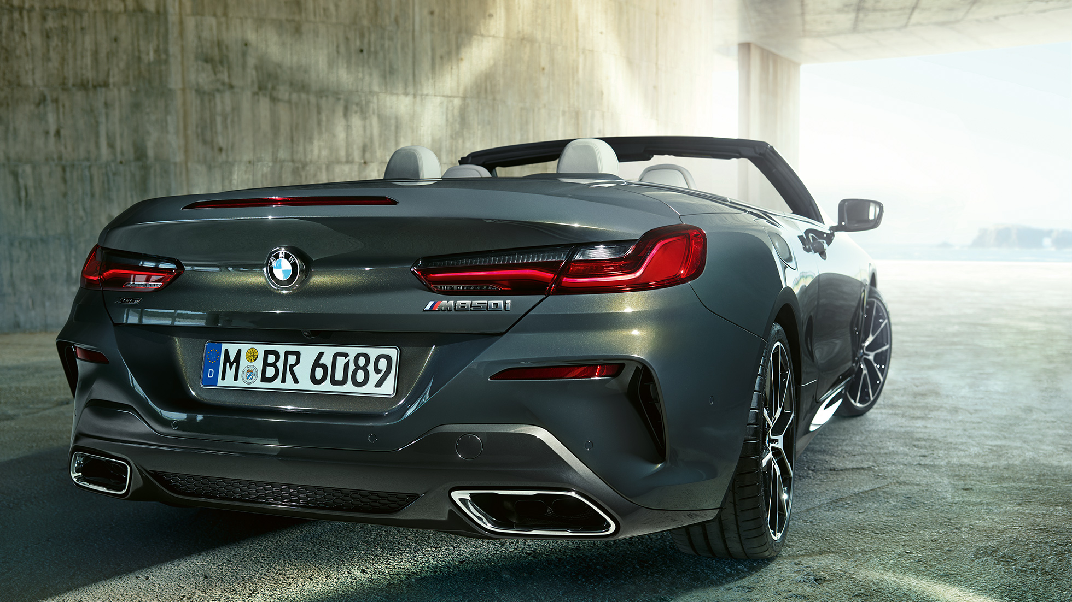
CONCLUSION
We cleaned the data and performed data pre-processing tasks such as discovering and managing null values, eliminating words from numbers, converting objects to int types, data visualization, and handling outliers and skewness, among other things. We started testing multiple machine learning regression techniques to discover the best performing model after separating our train and test data.
According to their r2 score and cross validation scores, the Extra Tree Regressor Algorithm performed well. Then, using Grid Search CV, we used the Hyperparameter Tuning approach to find the optimal parameters and improve the score. Although the Extra Tree Regressor Algorithm did not do as well as the defaults, we decided to use it for future forecasts because it was still better than the others. After receiving a dataframe containing anticipated and real used vehicle pricing details, we stored the final model in pkl format using the joblib package.

Slide 35
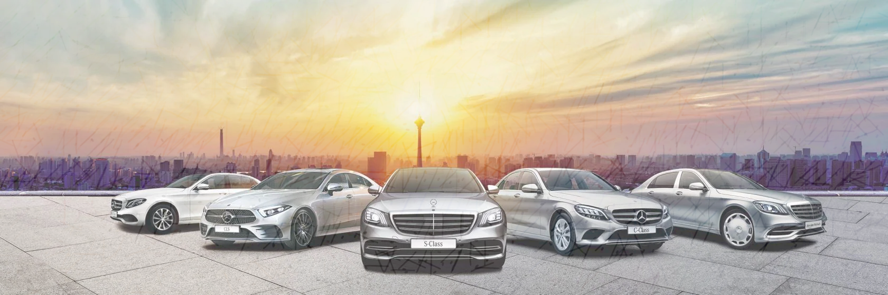
LIMITATIONS OF THIS WORK AND SCOPE FOR FUTURE WORK
The limitations we faced during this project were:
The website was badly constructed because scraping took a long time and getting the next page was difficult. In addition, I need more practise with various web scraping approaches. There were more negative connected data than positive correlated data. Outliers and skewness were found, and we had to lose some valuable data while dealing with them. Because no instructions for dealing with these fast-paced websites were supplied, the web scraping process took longer.
Future Work Scope:
The current model is confined to used car data, but by training the model appropriately, it can be enhanced for various types of automobiles. By training the model with more precise data, the overall score can be increased even more.

